Slide 1
16
Oligopoly

Slide 2

Figure 1 The Four Types of Market Structure
Number of Firms?
Many
firms
Type of Products?
One
Few
Differentiated
Identical
firm
firms
products
products
Monopolistic
Perfect
Monopoly
Oligopoly
Competition
Competition
(Chapter 15)
(Chapter 16)
(Chapter 17)
(Chapter 14)
•
Tap water
•
Tennis balls
•
Novels
•
Wheat
•
Cable TV
•
Crude oil
•
Films
•
Milk
Copyright © 2004 South-Western

Slide 3
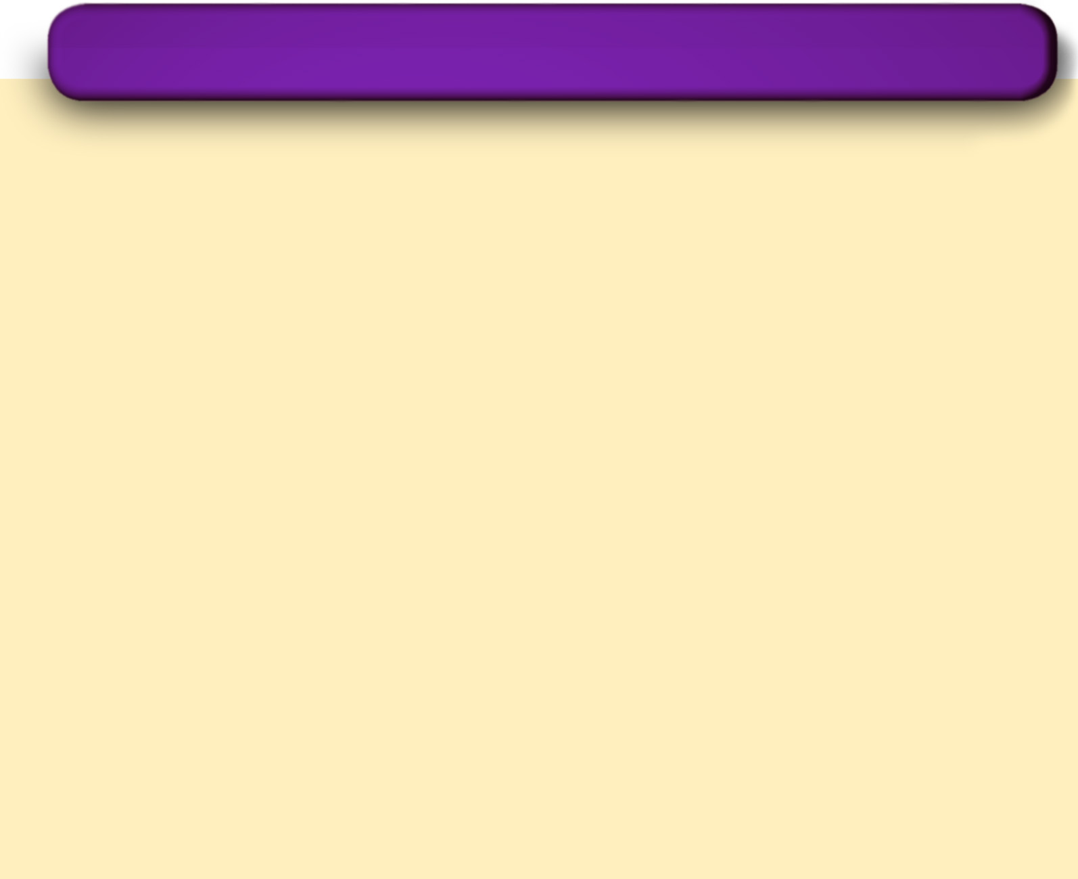
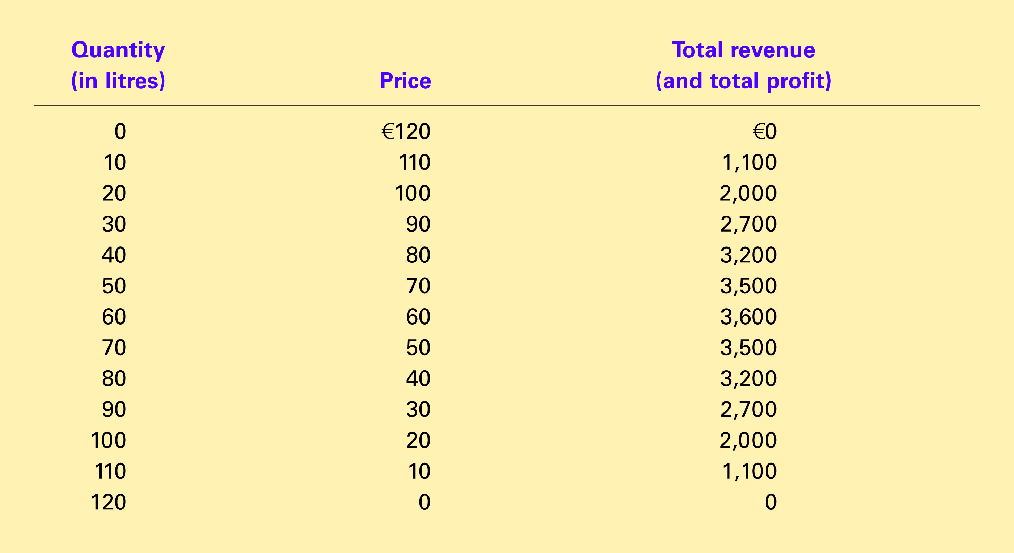
Table 1 The Demand Schedule for Water
Copyright © 2004 South-Western

Slide 4
Table 1 The Demand Schedule for Water
Copyright © 2004 South-Western

Slide 5
Figure 2 The Prisoners’ Dilemma
Mr Black’ s Decision
Confess
Remain Silent
Mr Black gets 8 years
Mr Black gets 20 years
Confess
Mr Pink’s
Mr Pink gets 8 years
Mr Pink goes free
Decision
Mr Black goes free
Mr Black
gets 1 year
Remain
Silent
Mr Pink gets 20 years
Mr Pink gets 1 year
Copyright©2003 Southwestern/Thomson Learning

Slide 6
Figure 3 An Oligopoly Game
Saudi Arabia’s Decision
High Production
Low Production
Saudi Arabia gets €40 billion
Saudi Arabia gets €30 billion
High
Production
Iran
’
s
Iran gets €40 billion
Iran gets €60 billion
Decision
Saudi Arabia gets €60 billion
Saudi Arabia gets €50 billion
Low
Production
Iran gets €30 billion
Iran gets €50 billion
Copyright©2003 Southwestern/Thomson Learning

Slide 7
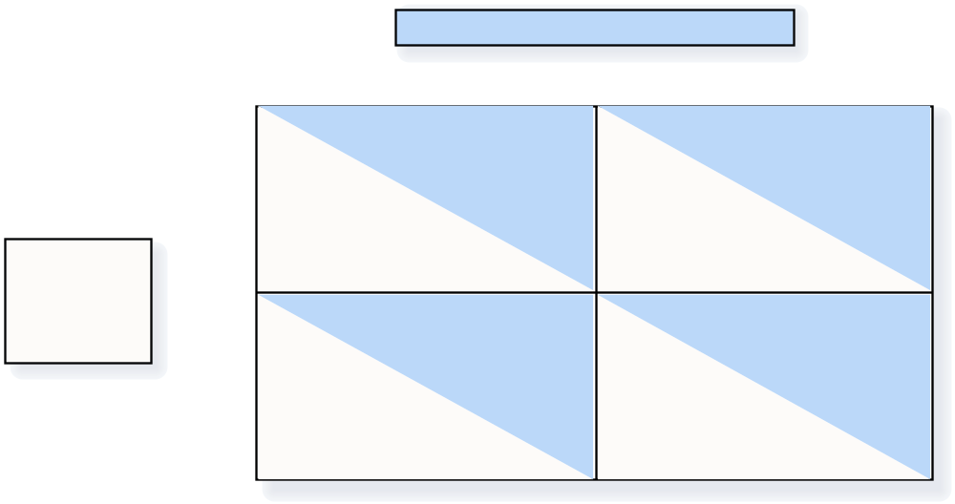
Figure 4 An Arms Race Game
Decision of the United States (U.S.)
Arm
Disarm
U.S. at risk
U.S. at risk and weak
Arm
Decision
USSR at risk
USSR safe and powerful
of the
Soviet Union
U.S. safe and powerful
U.S. safe
(USSR)
Disarm
USSR at risk and weak
USSR safe
Copyright©2003 Southwestern/Thomson Learning

Slide 8
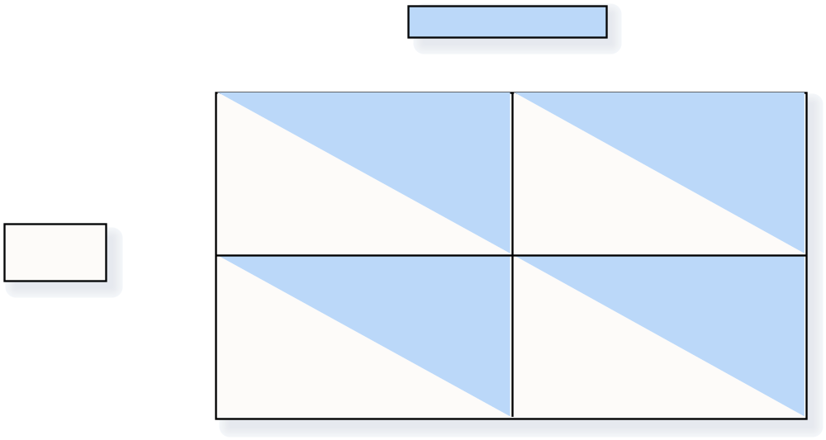
Figure 5 An Advertising Game
Marlboro’ s Decision
Advertise
Don
’
t Advertise
Marlboro gets $3
Marlboro gets $2
billion profit
billion profit
Advertise
Camel gets $3
Camel gets $5
Camel’s
billion profit
billion profit
Decision
Marlboro gets $5
Marlboro gets $4
billion profit
billion profit
Don
’
t
Advertise
Camel gets $2
Camel gets $4
billion profit
billion profit
Copyright©2003 Southwestern/Thomson Learning

Slide 9
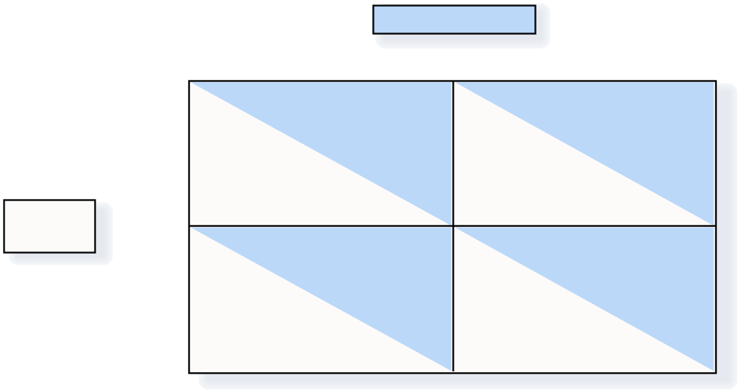
Figure 6 A Common Resources Game
Shell
’
s Decision
Drill Two Wells
Drill One Well
Shell gets €4
Shell gets €3
million profit
million profit
Drill Two
Wells
BP gets €4
BP gets €6
BP’s
million profit
million profit
Decision
Shell gets €6
Shell gets €5
million profit
million profit
Drill One
Well
BP gets €3
BP gets €5
million profit
million profit
Copyright©2003 Southwestern/Thomson Learning

Slide 10
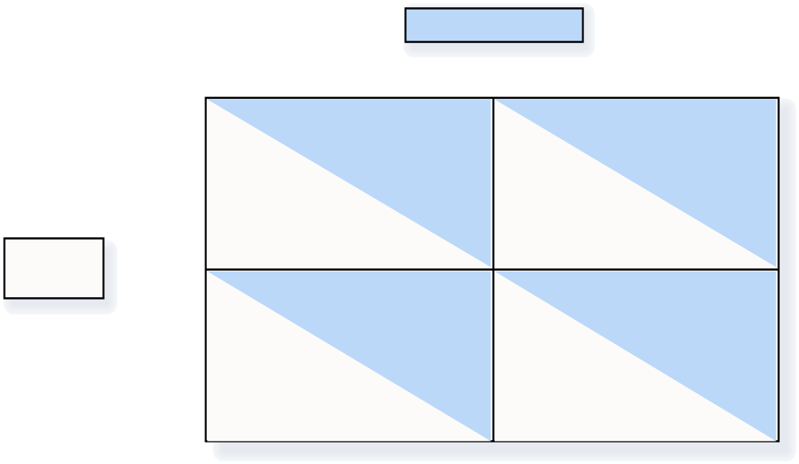
Figure 7 Jack and Jill Oligopoly Game
Jack’s Decision
Sell 40 litres
Sell 30 litres
Jack gets
Jack gets
€1,600 profit
€1,500 profit
Sell 40
litres
Jill gets
Jill gets
Jill’s
€1,600 profit
€2,000 profit
Decision
Jack gets
Jack gets
€2,000 profit
€1,800 profit
Sell 30
litres
Jill gets
Jill gets
€1,500 profit
€1,800 profit
Copyright©2003 Southwestern/Thomson Learning

